Slide 1

Intro to Unity – Hello World!
By: Jeremy nIELSON

Slide 2

What is Unity Anyways?
First announced in June 2015
Multi-platform game-engine
27 platforms supported
Developed in C++/C#

Slide 3
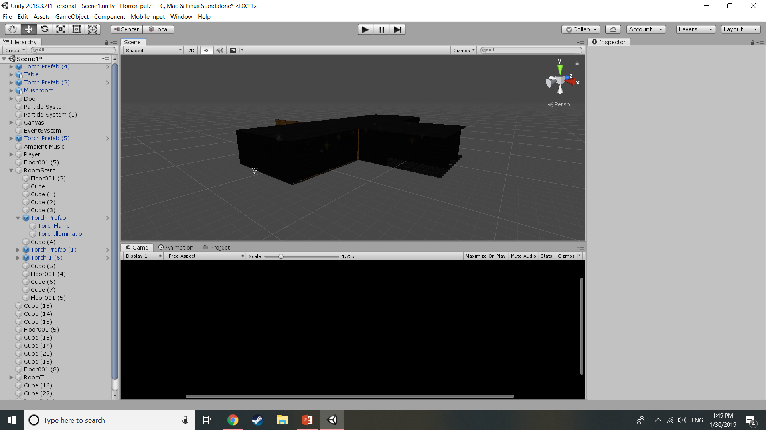
Why use Unity?
It’s FREE for personal use
Easy to setup and get going
Plenty of online resources
Well-established community
Widely used in the industry
Great starting point

Slide 4


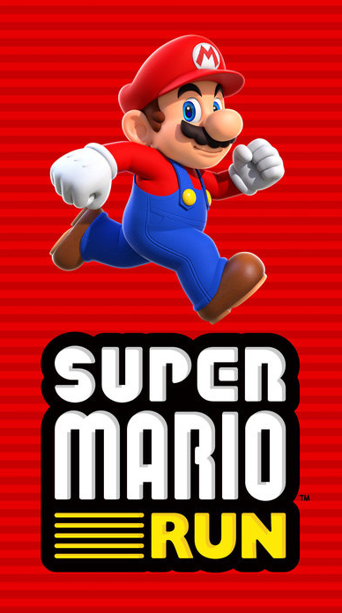


Examples of Unity Games

Slide 5
Initial Set Up
Meet basic system requirements
https://unity3d.com/unity/system-requirements
Download & Install Unity
https://store.unity.com/download?ref=personal
You will have to create a Unity account or login with Facebook/Google

Slide 6
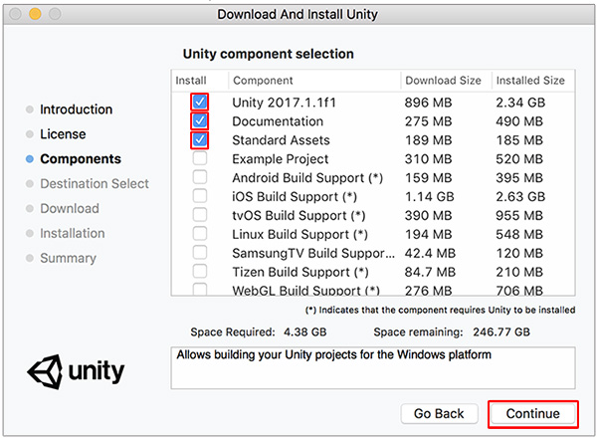
Installation Overview
At minimum, select the options to the right.
These may differ based on the version of Unity you run
If running 2018.3.11f1, generally speaking you only need what it defaults to.

Slide 7
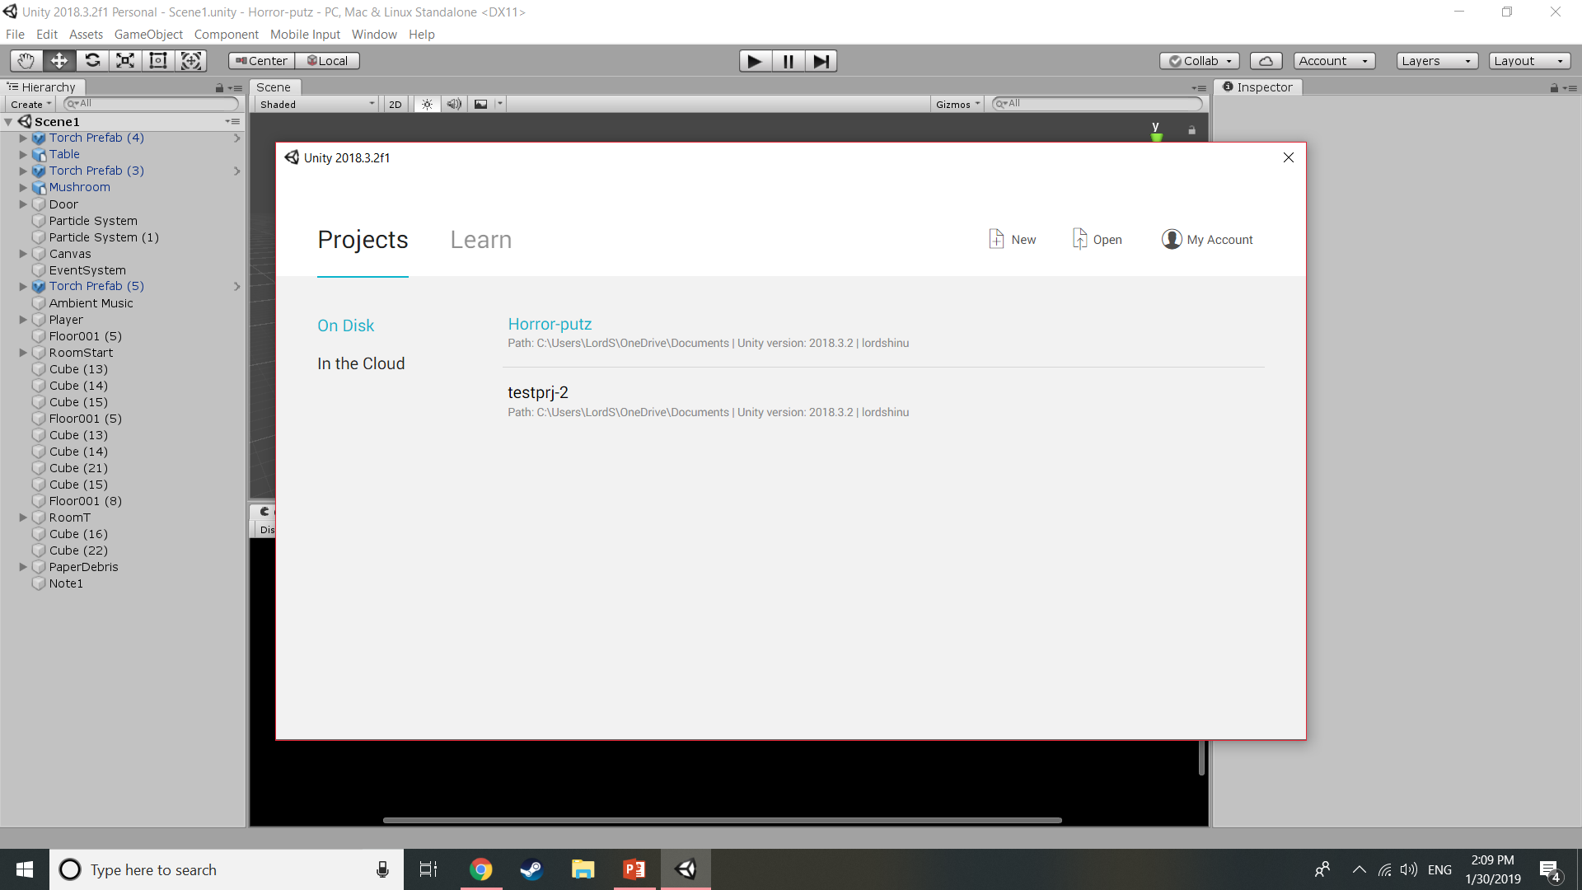
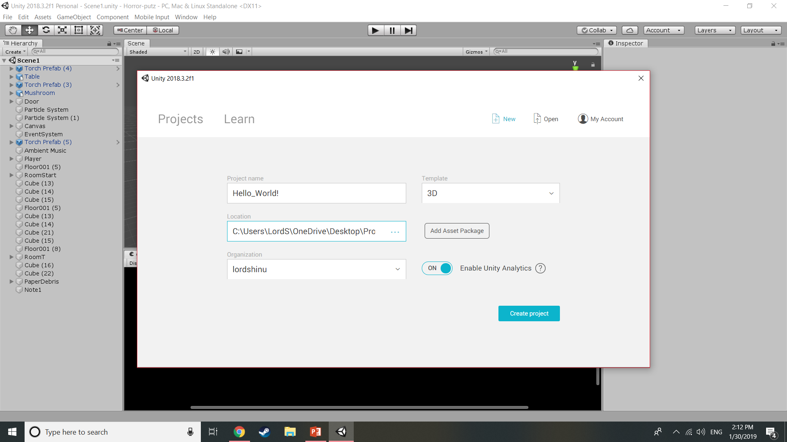
First Project Setup
Select Projects > New
Fill the fields appropriately
Create project!

Slide 8
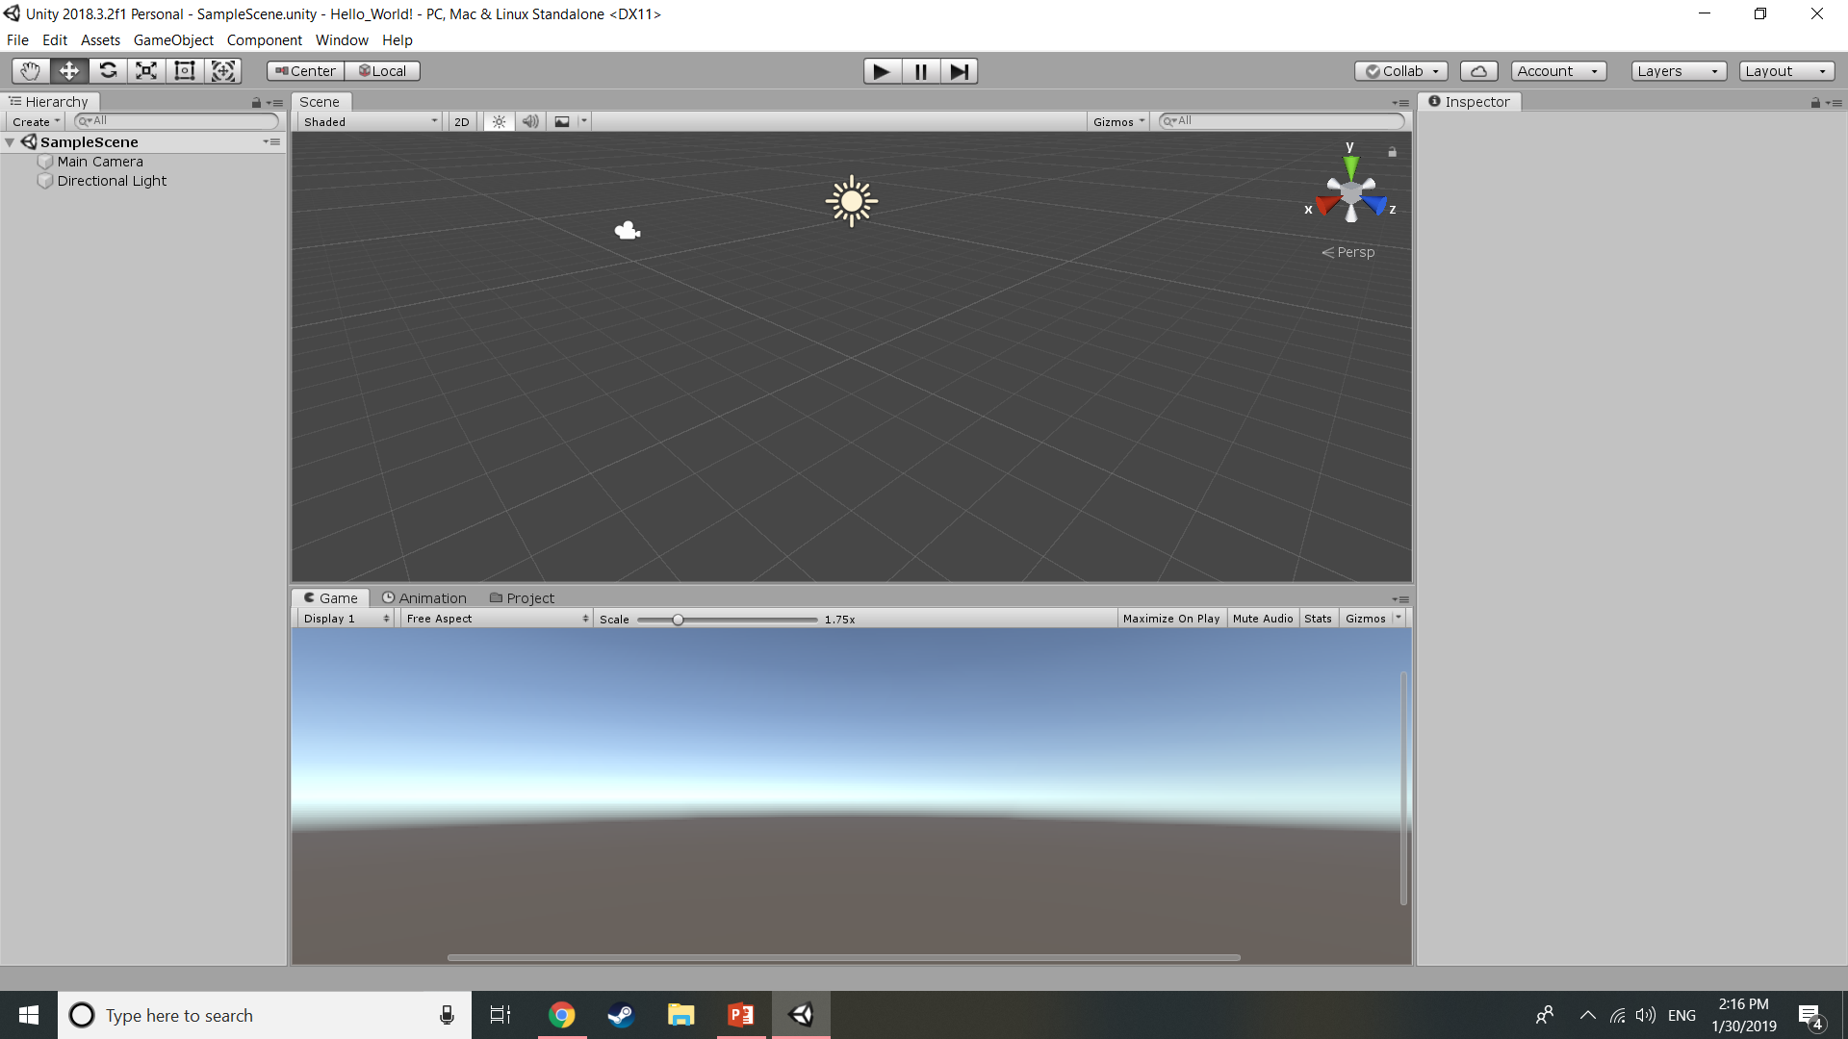
What You Should See…

Slide 9
Tab Overview
Hierarchy: Scenes and their respective objects/contents
Scene: Preview of the current scene (levels, worlds, etc.)
Game: Playtest tab, what the game sees
Inspector: View elements of each object and their components
Project: All materials, textures, etc. imported into current project
Animation: Animate objects in the world automatically

Slide 10
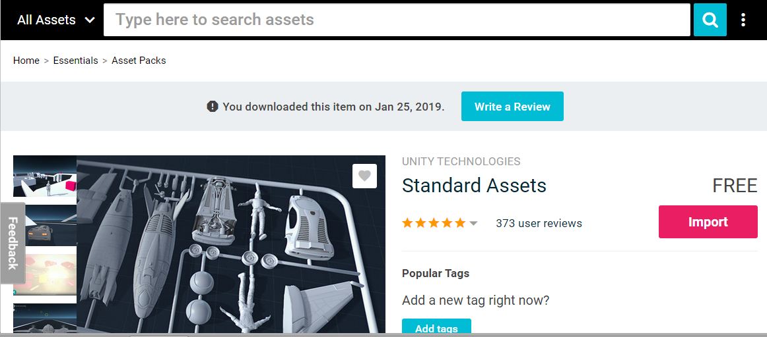
Hello World: Standard Assets
IF you didn’t install Standard Assets…
Window > Asset Store (Ctrl + 9)
Search Standard Assets by Unity
Install and Import
You will only need for this part:
Characters (Player Controllers)

Slide 11
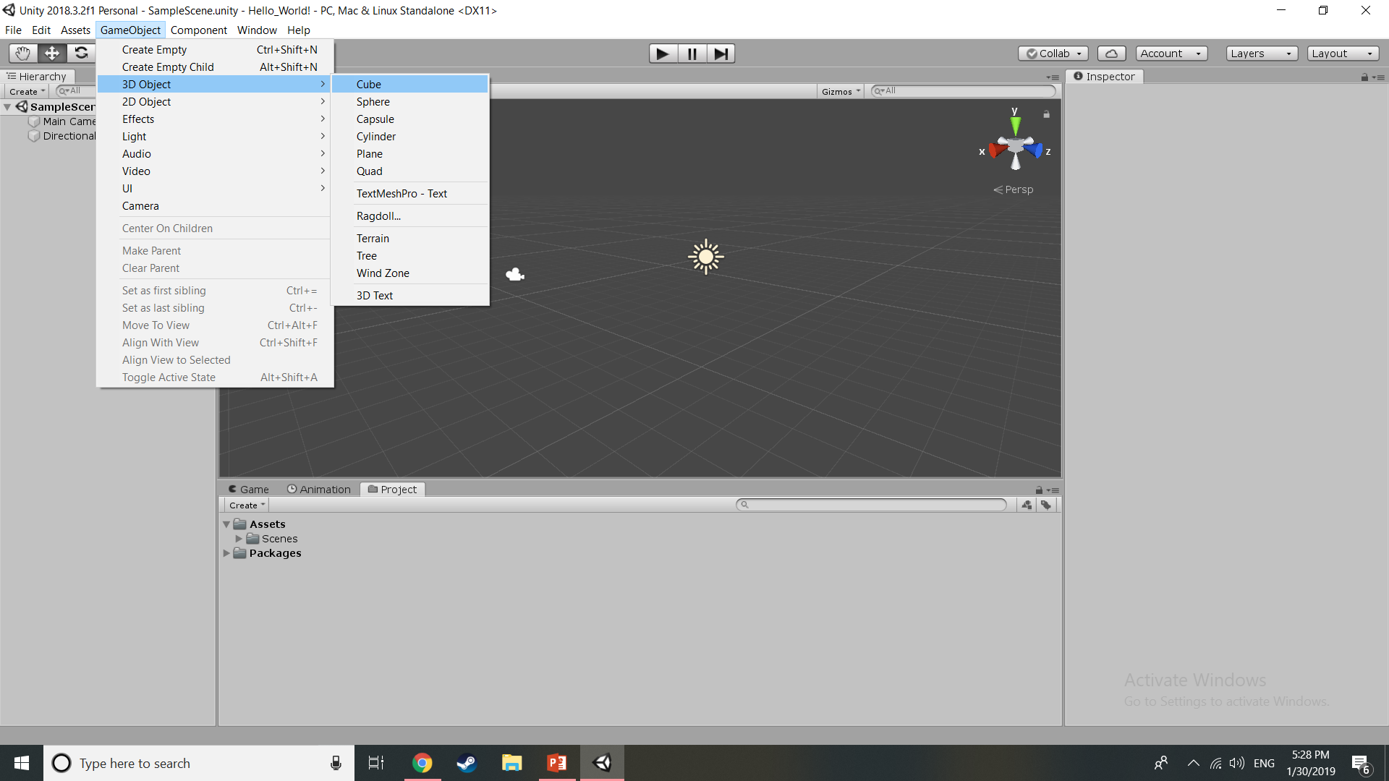
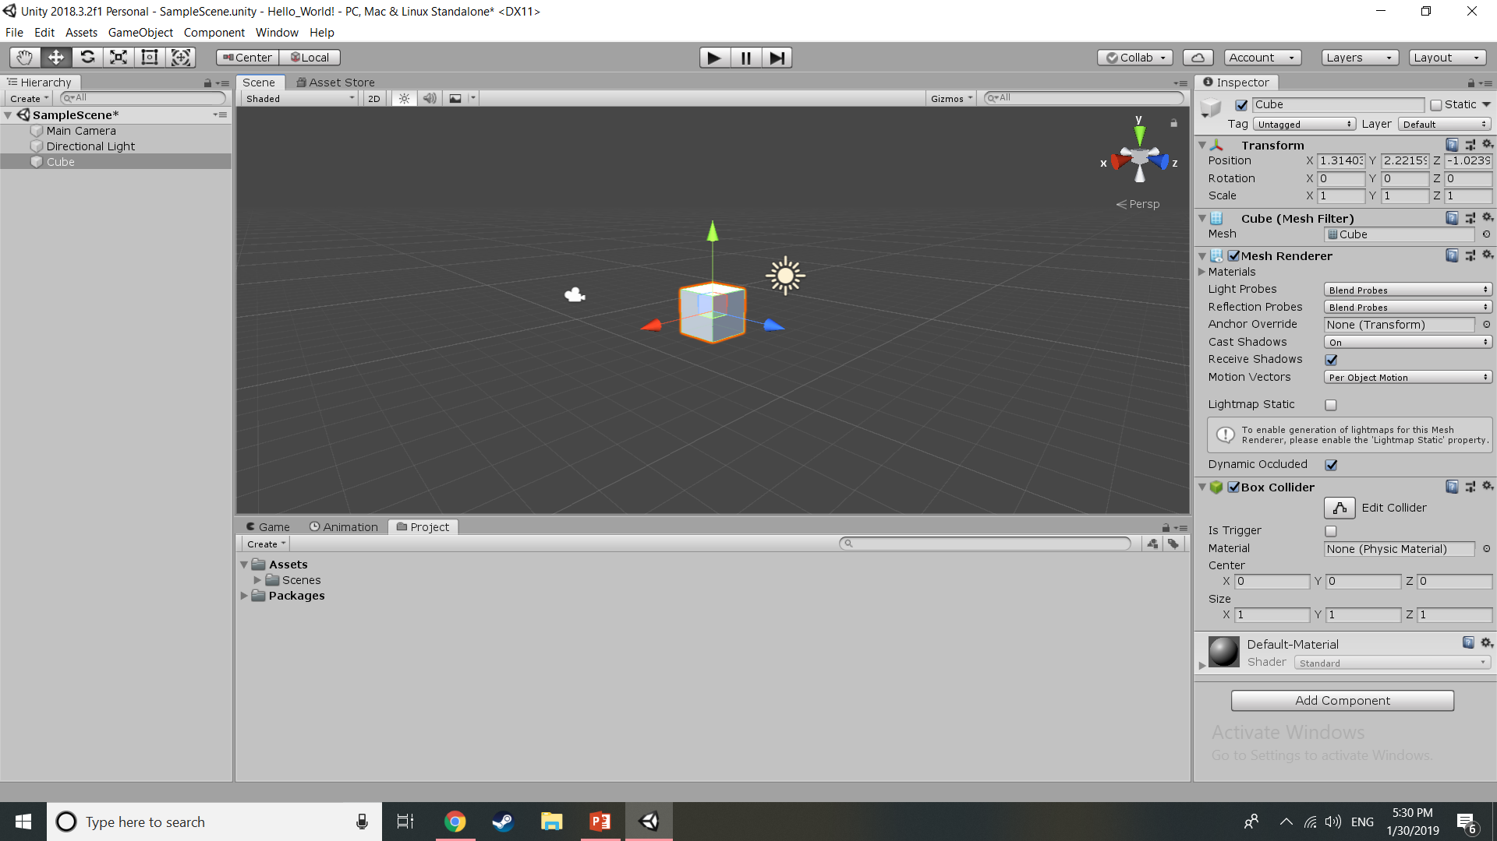
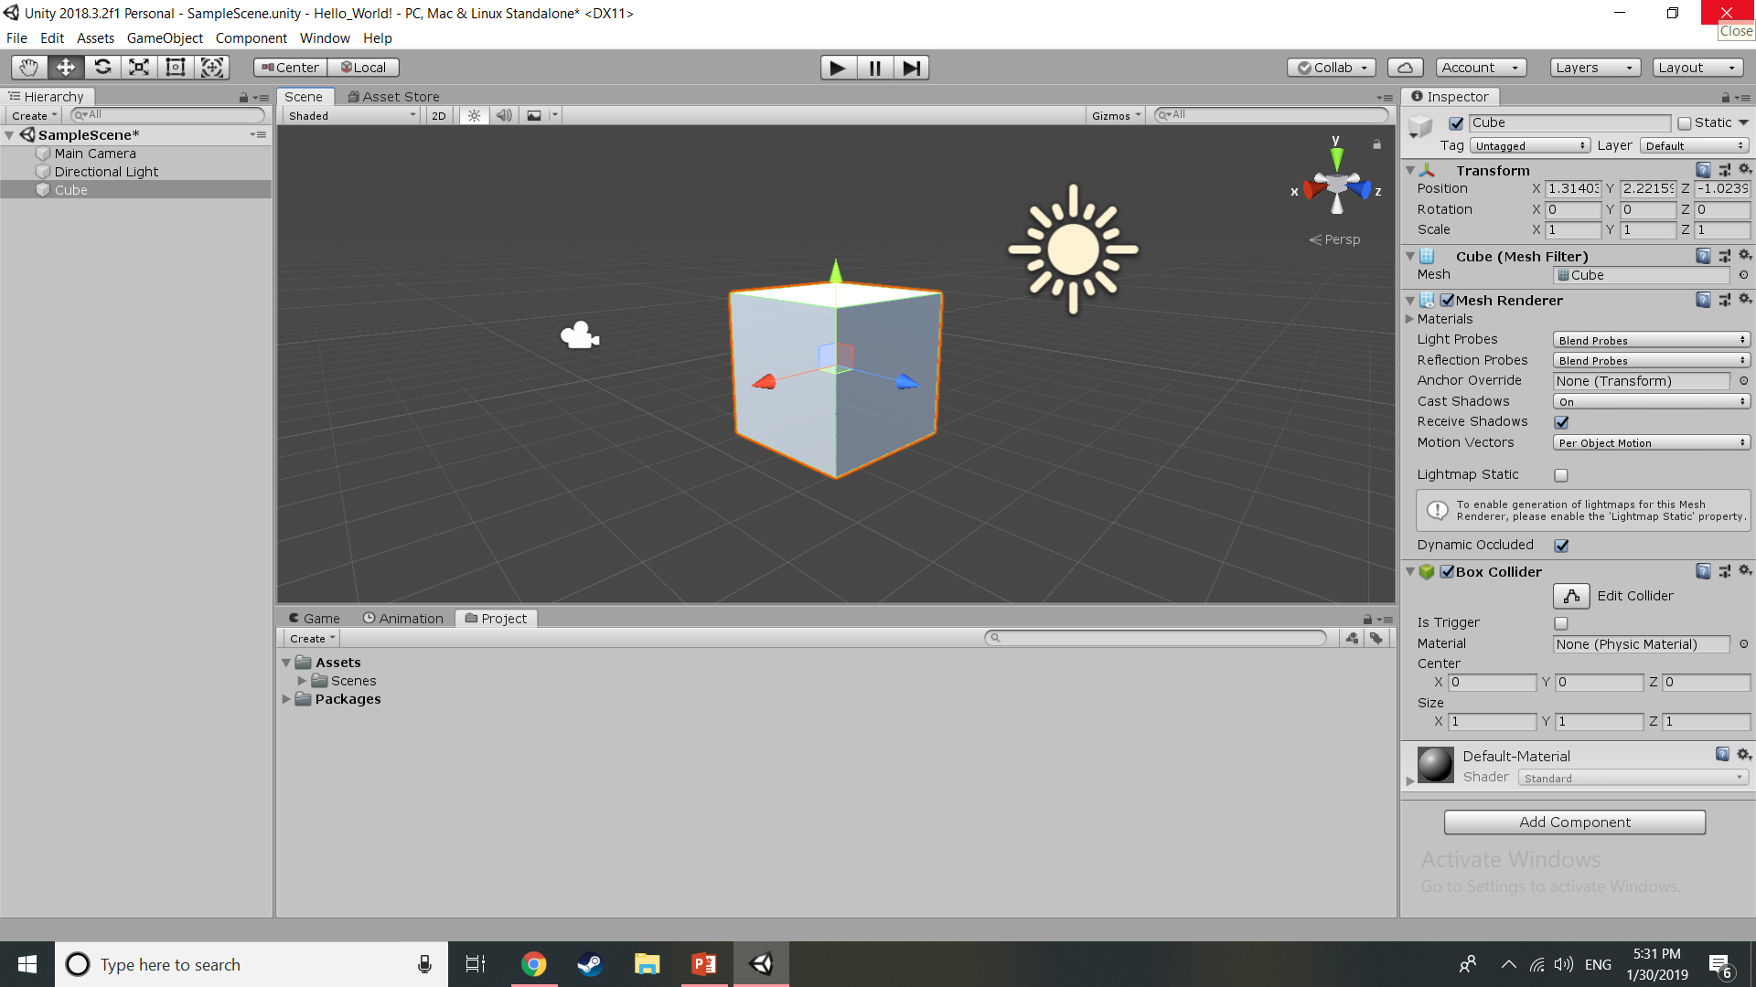
Hello World: Create a Cube
All objects under“GameObject”
Inspector Elements:
Changes will be reflected in Scene
Rename “Cube” to “Floor”
Set Scale and Position
Position - X: 0 Y: 0 Z: 0
Scale - X: 25 Y: 0.5 Z: 25

Slide 12
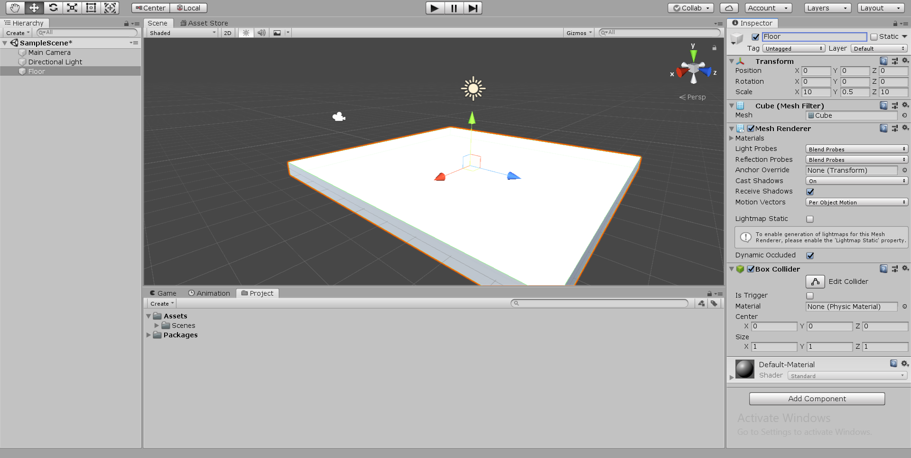
Hello World: First Object

Slide 13
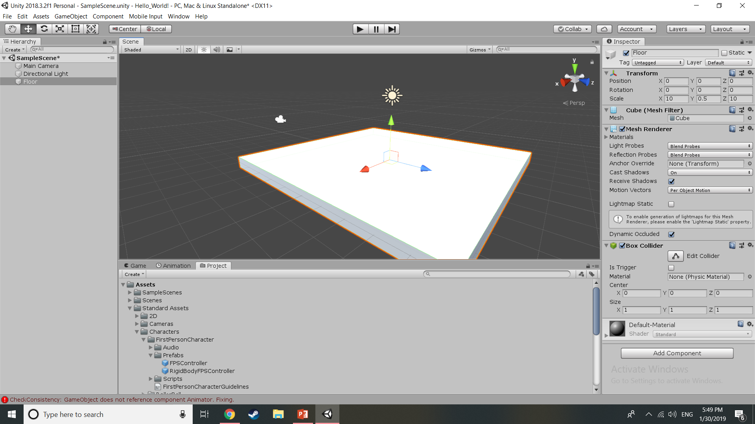
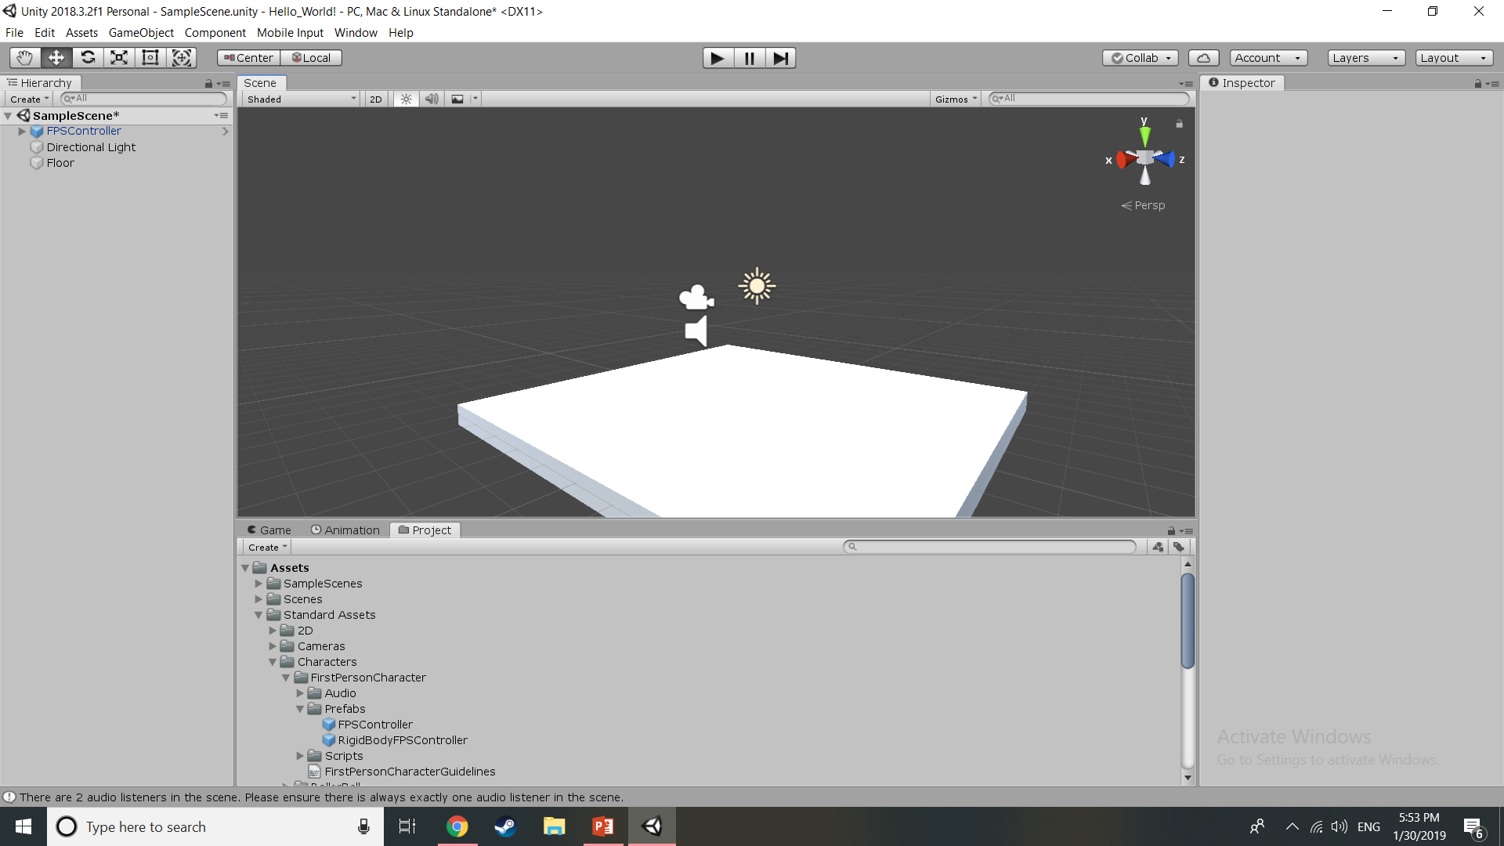
Hello World: FPS Character
Under Project Tab:
Select FPSController shown on the right
Set Position – X: 0 Y: 2 Z: 0
Select Camera under Hierarchy
Delete it

Slide 14
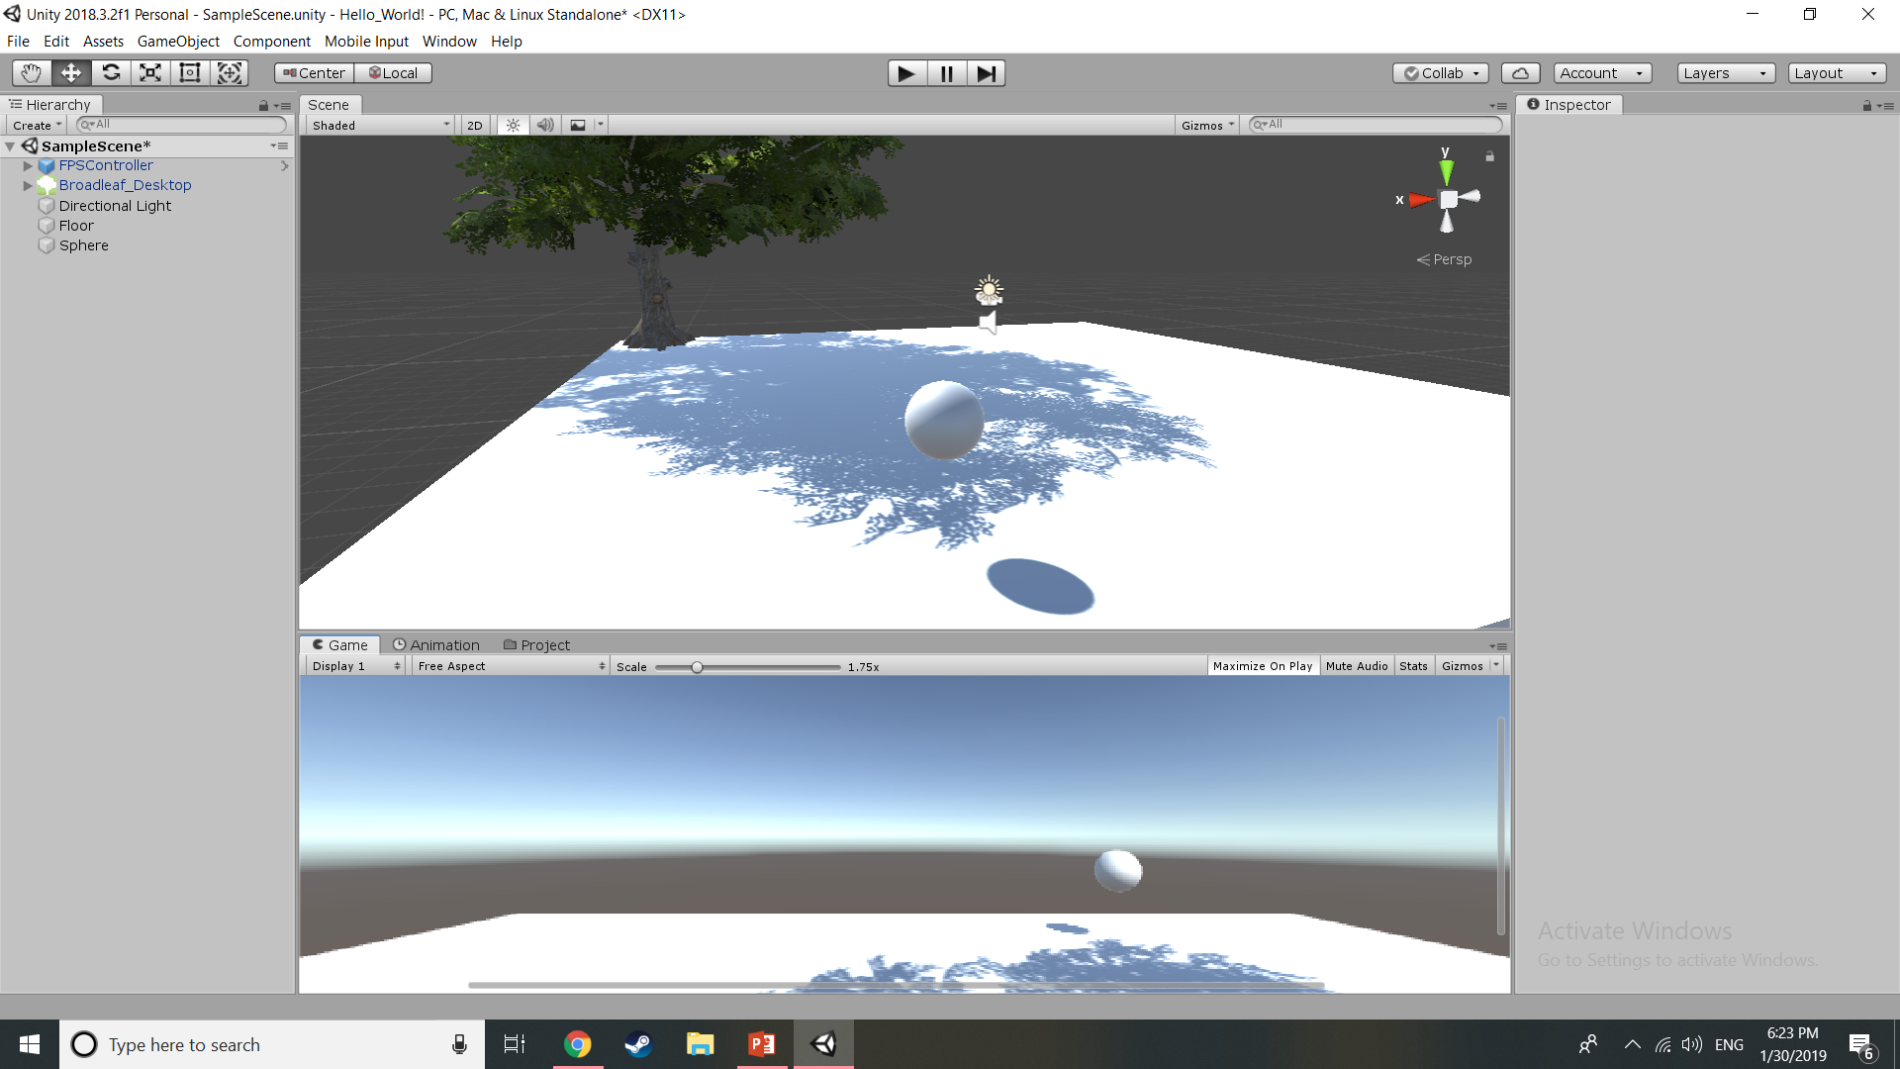

Hello World: Play the Game!
Open the Play tab
Click“Maximize on Play”
Click the Play button at the top
You can now walk around and play in your world!
Press escape when you are done
Click Play again
File > Save Project

